Slide 1
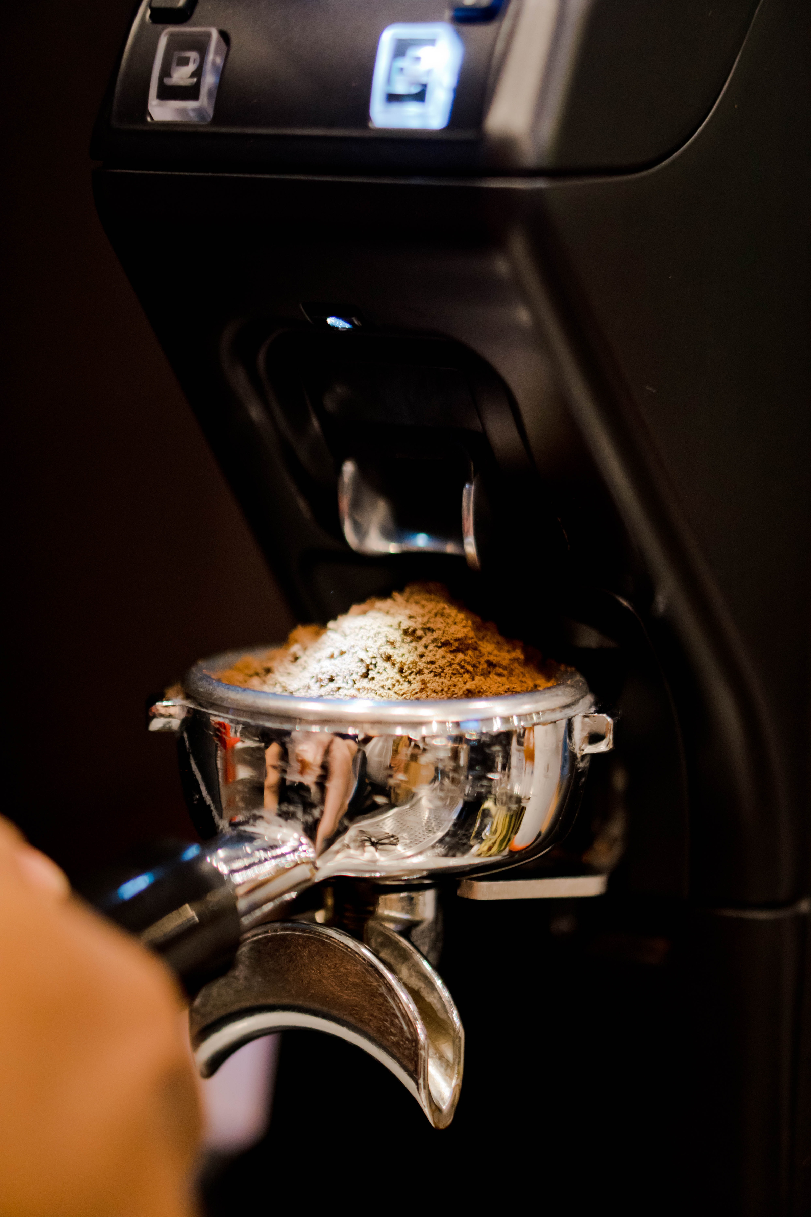





MONDAY COFFEE
MONDAY
CITY SELECTION ANALYSIS
Coffee
Manish Jangir

Slide 2
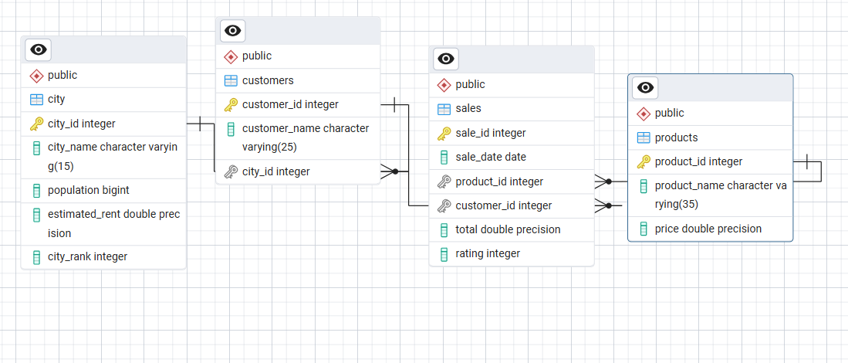
MONDAY COFFEE
OBJECTIVE & DATA
Objective: Recommend top 3 Indian cities for opening Monday Coffee branches.
Data: Sales, customers, products, city metrics.
Assumptions: 25% population are coffee consumers; sales.total is transaction amount.

Slide 3
MONDAY COFFEE
METHODOLOGY
First
Second
Compute metrics: total sales, total customers, estimated coffee consumers (25% pop).
Compute avg sale per customer and avg rent per customer.
Third
Create composite market score (sales 40%, customers 35%, consumers 25%).

Slide 4

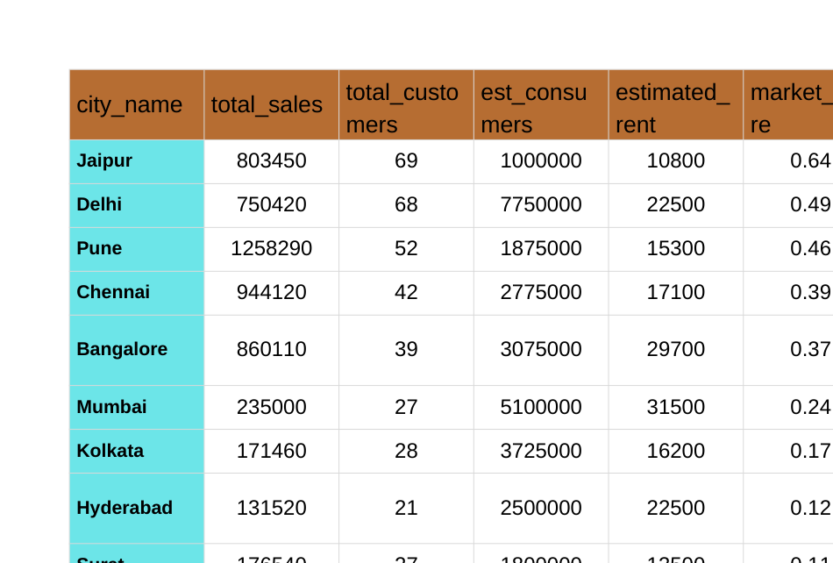
TOP CITIES — KEY METRICS

Slide 5
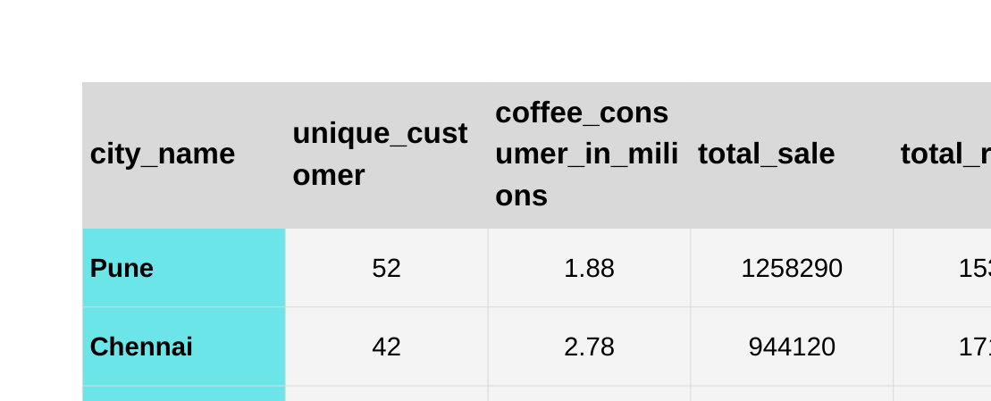
TOP CITIES — KEY METRICS

Slide 6
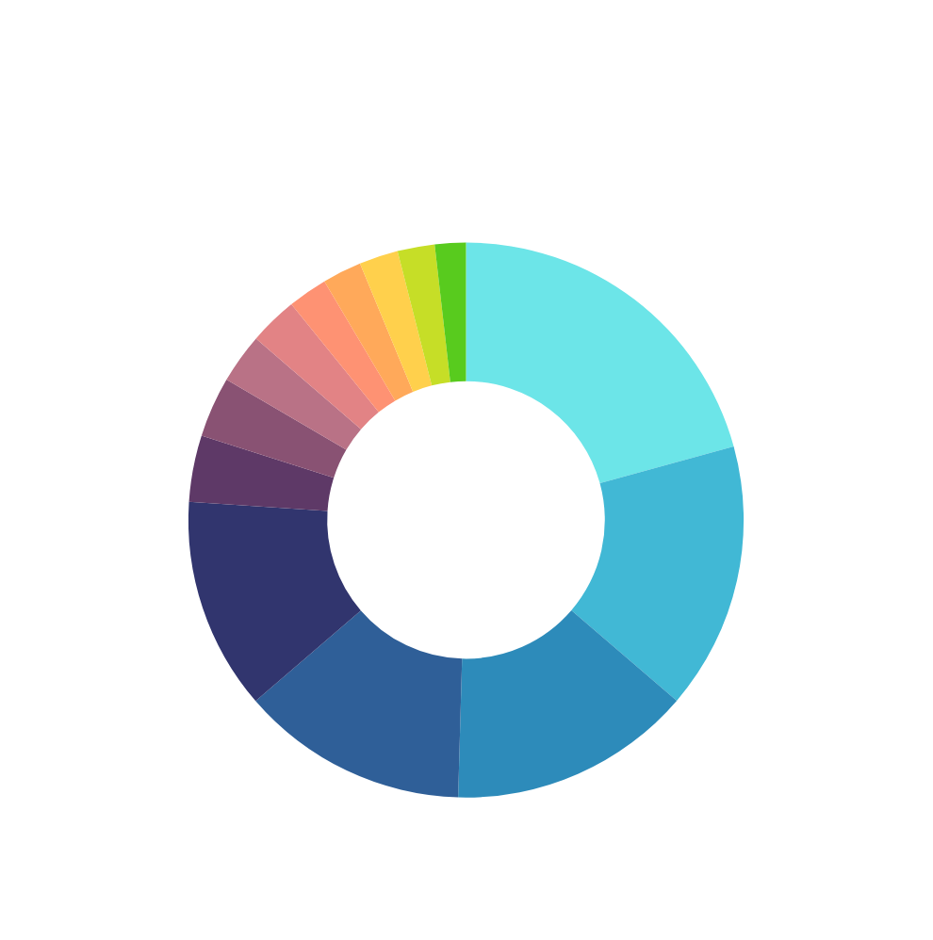

KEY PARAMETERS AND MARKET SCORE

Slide 7
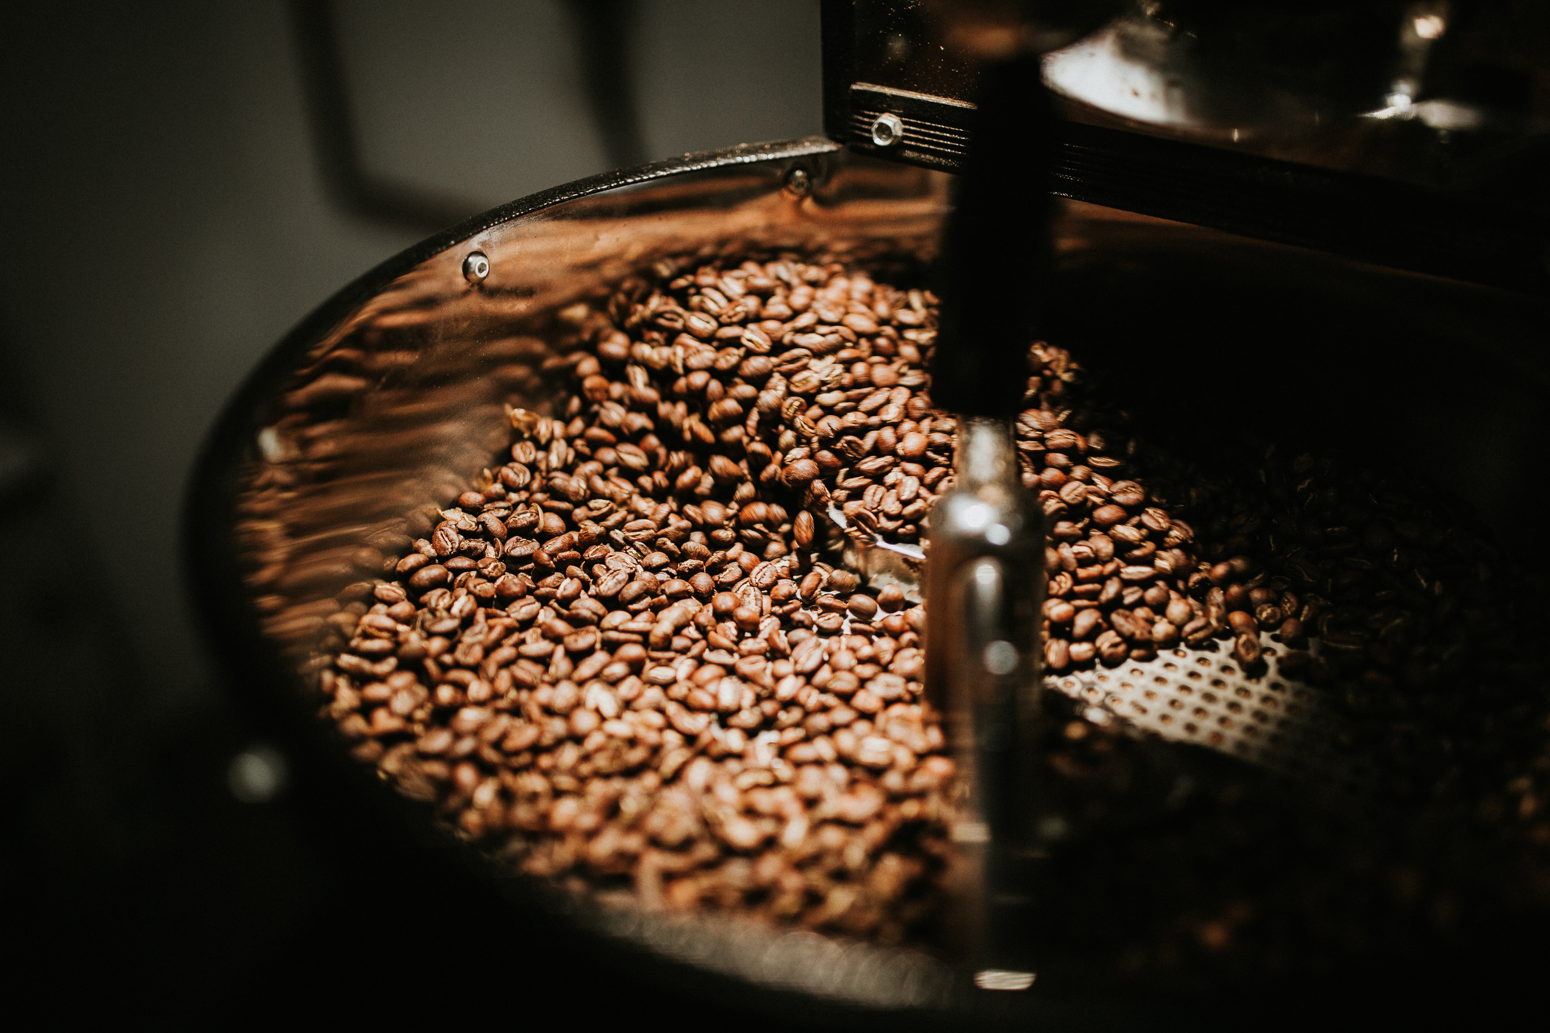
TOP 3 RECOMMENDED CITIES
City 1: Pune
Average rent per customer is very low.
Highest total revenue.
Average sales per customer is also high.
City 2: Delhi
Highest estimated coffee consumers at 7.7 million.
Highest total number of customers, which is 68.
Average rent per customer is 330 (still under 500).
City 3: Jaipur
Highest number of customers, which is 69.
Average rent per customer is very low at 156.
Average sales per customer is better at 11.6k.

Slide 8
RISKS & NEXT STEPS
Risks (top 3)
Data & assumption risk: sales/rent figures may be estimated or inconsistent.
Site & rent variability: neighborhood rents and footfall can differ widely from city averages.
Operational & competition risk: supply, staffing, and existing chains may slow ROI.
Next steps (quick 4-step plan)
Validate data (1–2 wks) — confirm sales.total, rent units, and population sources.
Scout 3 sites/city (2–4 wks) — collect rent quotes, footfall, competitor map.
Run 90-day pilot(s) — launch 2 pilots (one high-potential, one low-cost); track daily POS metrics.
Go / No-go decision (post 90 days) — use pre-set KPI gates (transactions, avg ticket, CAC) to scale or revise.

Slide 9

THANK
You

